Slide 1
DHIS2 Data Quality Validation Rules and Notifications
DQ Academy, Day 4 – Oct 22
Part 1 – Building validation rules

Slide 2
Objectives – Bring DQ to the user
Understand the logic behind validation rules
Know how to build validation rules

Slide 3
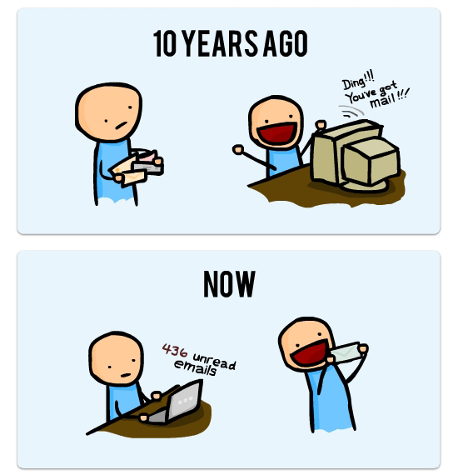
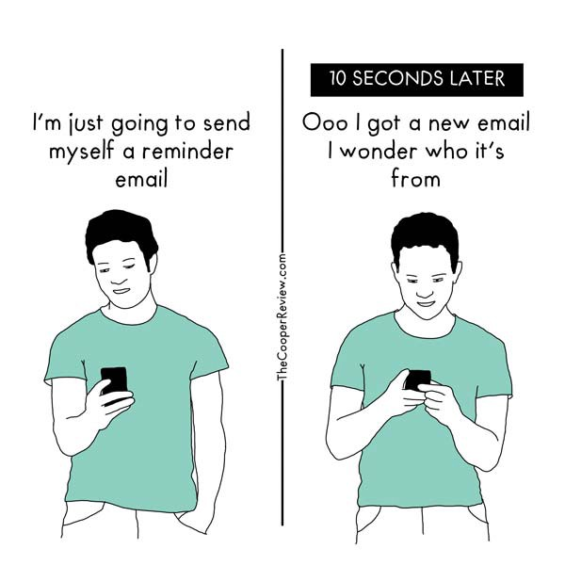
Our email is everything.

Slide 4
Main Principal
Send data quality issues to the user.
Data use is low because data trust is low.
Data trust is low because people can not see the DQ issues.
Data quality issues are a feature of the system not a failure.
The failure is not being able to do something about it.
Make it so everyone can see the DQ issues.
Send DQ alerts to where people spent their time:
Email
SMS
Whatsapp
In the alerts tell them what they need to do based upon defined SoPs
Don’t make people guess or figure it out on their own.

Slide 5
Understanding the Logic of Validation Rules
A way to assess the quality of Data that have been entered in DHIS2
Based on a set of predefined rules set for the data
This does NOT allow you to FULLY assess whether or not reported numbers are completely accurate

Slide 6
Validation Rules
An expression that defines a relationship between a number of data elements
Expression has Left side, right side and an operator
Common operators are: less than, equal to or greater than
You create Validation Rules based on what you know to be true e.g.
‘Malaria RDT positive’ should always be LESS THAN ‘Malaria RDT tested’

Slide 7
When to use validation rules:
During aggregate data entry
Will be triggered during data entry
Can be used to block data entry if not passed
Only use for well trained users
Can be run manually at any time in the data quality application
Can be done before supervision visits or planning meetings
Can trigger email or SMS alerts if validation rule notifications have been configured.
Scheduled to run automatically
Any validation rule can be schecheduled to run at any point.
Can trigger email or SMS alerts if validation rule notifications have been configured.

Slide 8
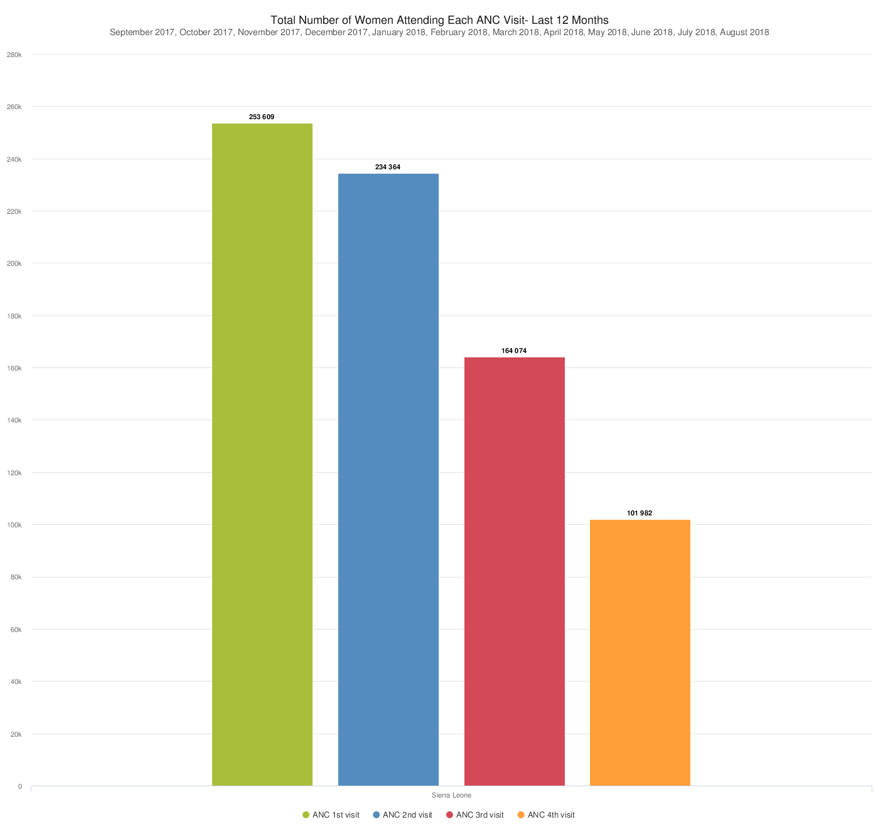
Let’s make an example of a validation rule
What are some possible validation rules?
Let’s make ANC4 <= ANC1

Slide 9
Building Validation Rule: Steps
Make the validation rule
Assign it to a validation rule group
Test the validation rule
Make a validation notification
(Optional) schedule the validation rule group to run automatically
Write protocol and guidlines on how to use validation rule group

Slide 10
Make a validation rule
https://academy.demos.dhis2.org/dqapp-config/

Slide 11
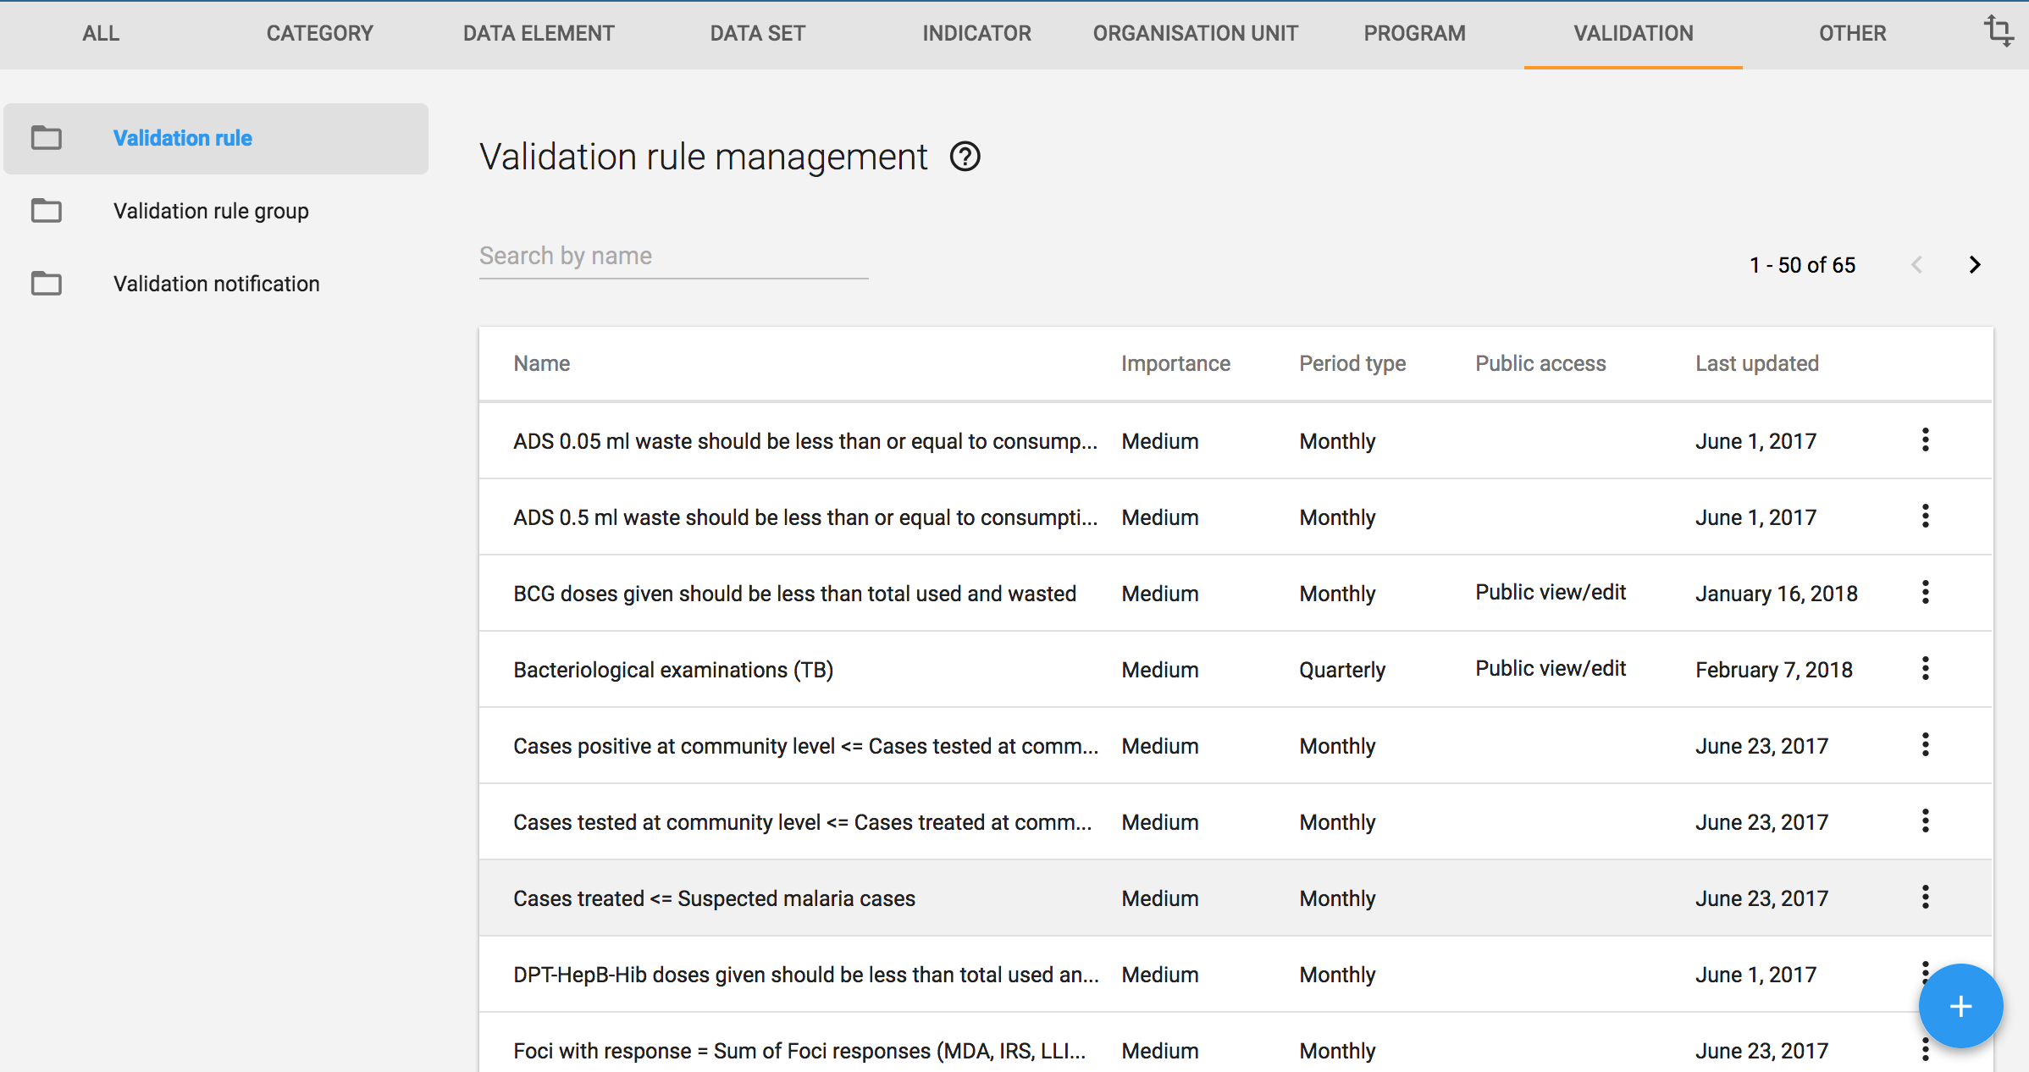
Building Validation Rule
Add New

Slide 12
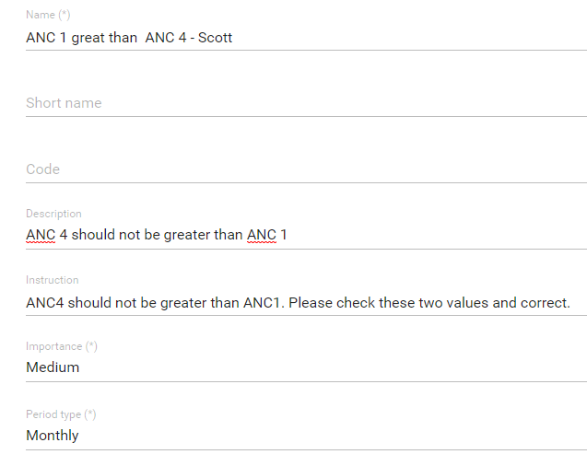
1. Add a name:
ANC 4 <= ANC 1 – YOUR NAME
2. Add description:
ANC4 should not be greater than ANC3.
3. Add instructions:
ANC4 should not be greater than ANC1. Please check these two values and correct.
4. Importance:
Medium (High for things you know to be wrong or disease outbreak)
5. Period type:
Monthly (Should be at least the same as the frequency of data capture)

Slide 13
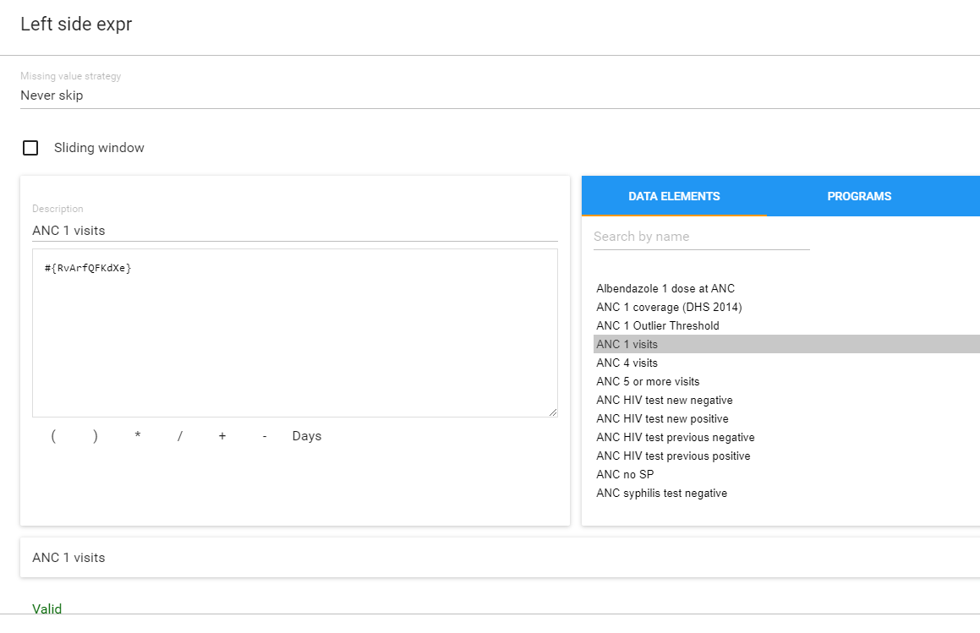
Left Side – ANC 1
Choose Missing value stratigy
-> Select Never Skip

Slide 14
Left Side – ANC 1
Write ‘ANC 1 visits’ for the description
Search ‘ANC 1’
Add ANC 1 visits
Check if equation is valid
Save

Slide 15
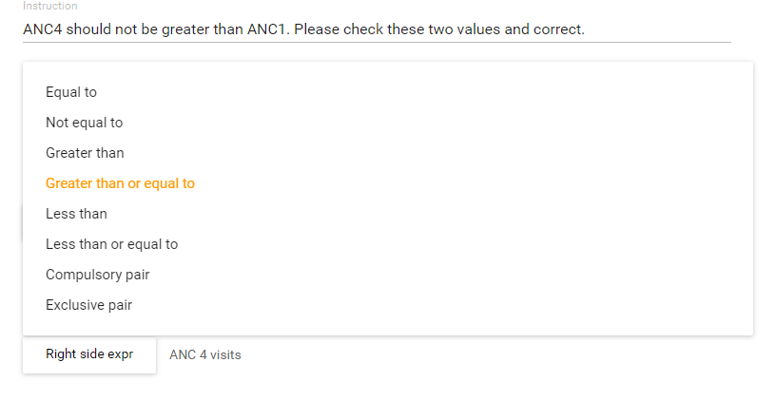
Choose Operator
1. Select ‘Greater than or equal to’

Slide 16
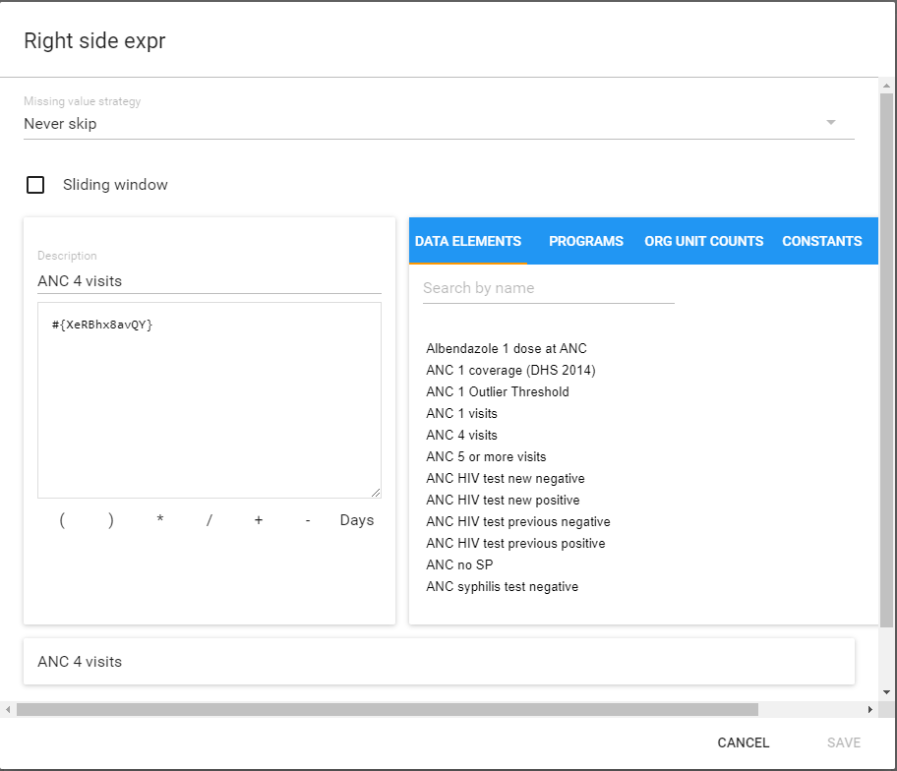
Right Side – ANC 4
Write ‘ANC 4 visits’ for the description
Search ANC 4 visits
Add ANC 4 visits
Equation is valid
Save

Slide 17
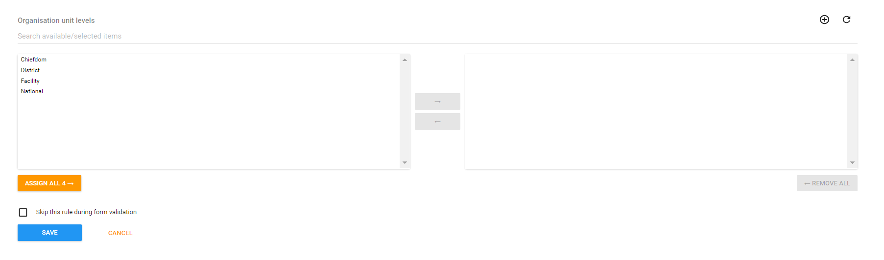
Save the validation rule
Org. Unit levels – Sets the level that the validation rule will run for. Nothing selected means that it will run for the org unit level for which the data was captured.
Skip this rule during form validation will not notify the user during data capture if the rule is triggered
Save

Slide 18
Creating Validation Rules & Group
Once you have created a set of validation rules, you need to put them in groups e.g. malaria for ease of analysis
This group is what you will select in your Validation Rule Analysis
The output will test every rule in the Group and show you EVERY TIME a rule was violated within your specified time and place!
Notes:
****Change to demo and put in trainer's guide

Slide 19
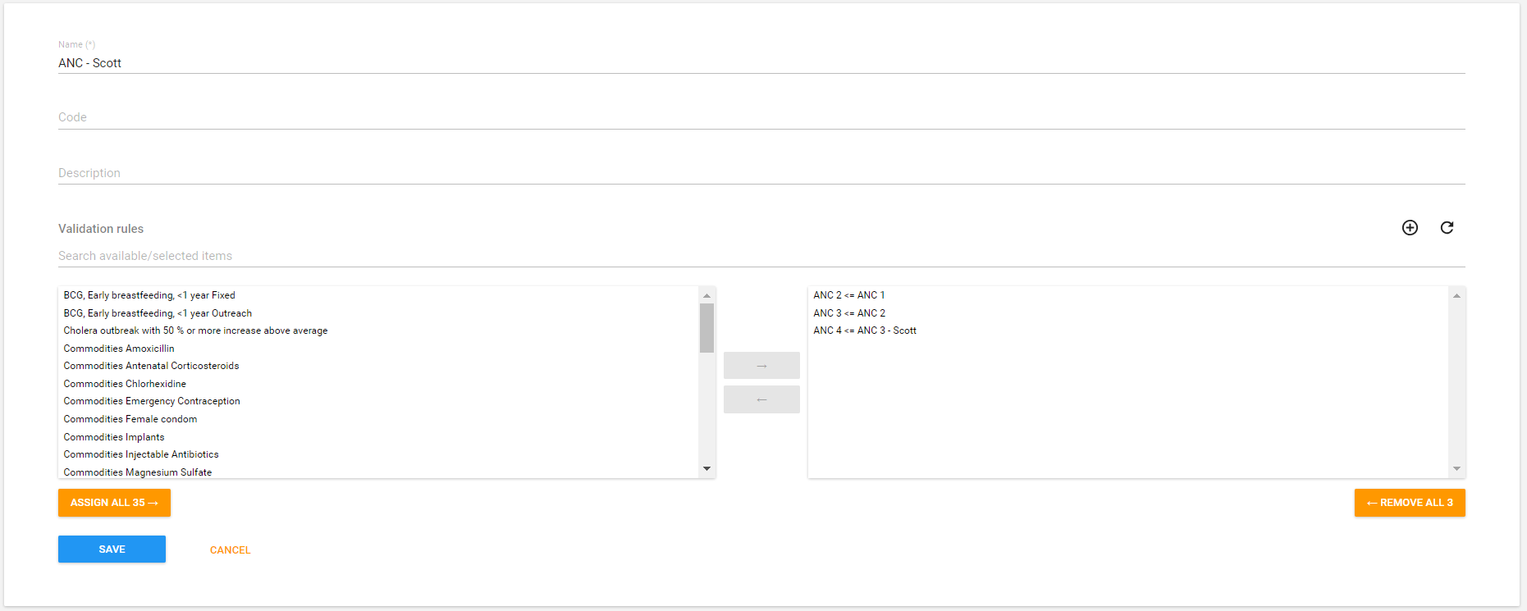
Making the validation rule group: ANC – YOUR NAME

Slide 20
Data Quality/Validation and Validation rules Notifications
Part 2 – Running and scheduling validation rules

Slide 21
Objectives
Learning Objectives
Be able to set up validation rules notifications
Be able to run validation rule analysis
Be able to schedule validation rules to run automatically

Slide 22
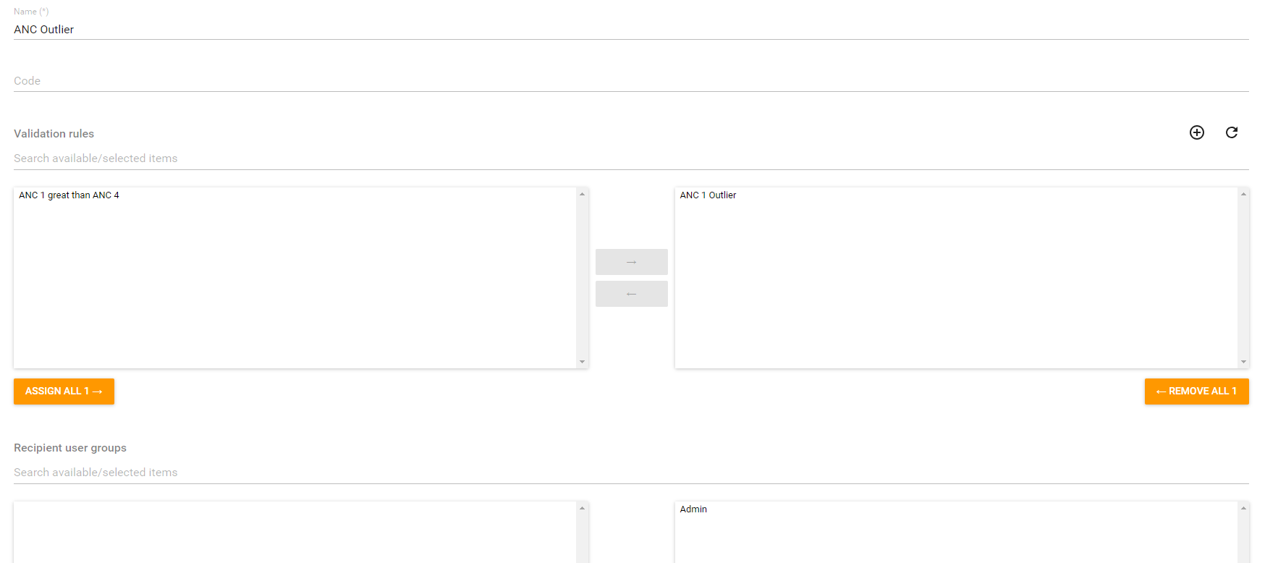
Make validation rule notification

Slide 23
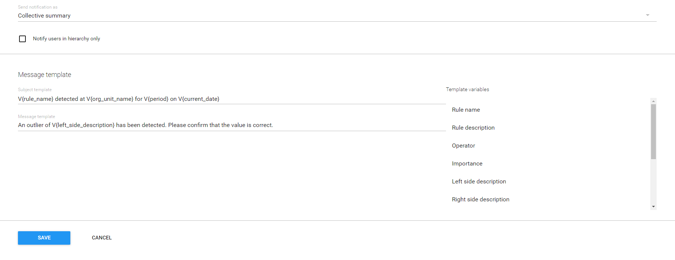
Make validation rule notification

Slide 24
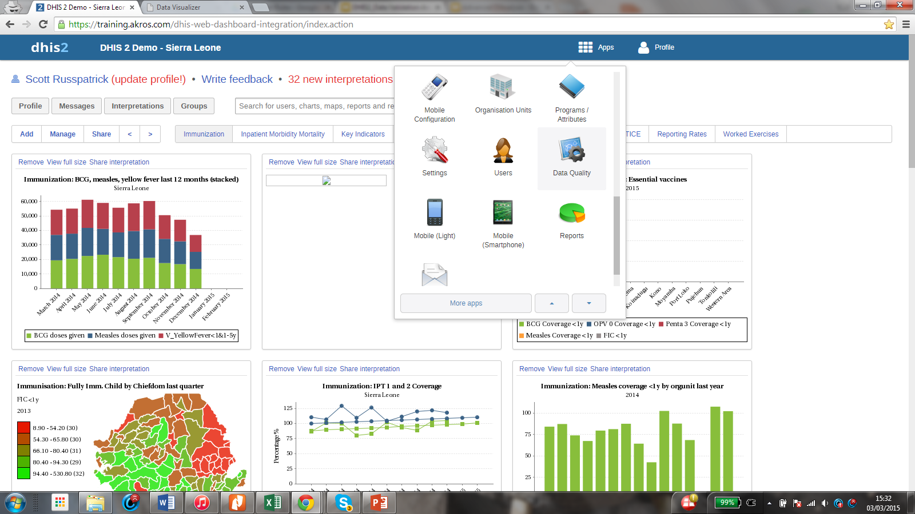
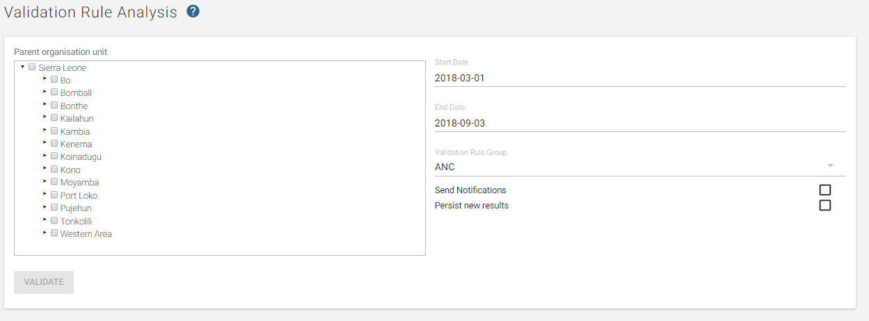
Running Validation Rule Analysis: Finding WHERE to do this

Slide 25
Validation Rule Analysis
1. Select your organisational units
Selecting the whole country may return hundreds of alerts (and takes a while and may crash the system)

Slide 26
Validation Rule Analysis
2. Select your date range
Selecting a large date range may return hundreds of alerts.

Slide 27
Validation Rule Analysis
3. Select your validation rule group

Slide 28
Validation Rule Analysis
4. Choose if you want to send notifications
Will send notifications as defined by the validation notification
Nothing will be sent if there are not configured notifications

Slide 29
Validation Rule Analysis
5. Select if you would like to presist new results
This will save the results of the validation rule analysis. Saved results can then be accessed via the API. Becomes more important when we talk about scheduling validation rules

Slide 30
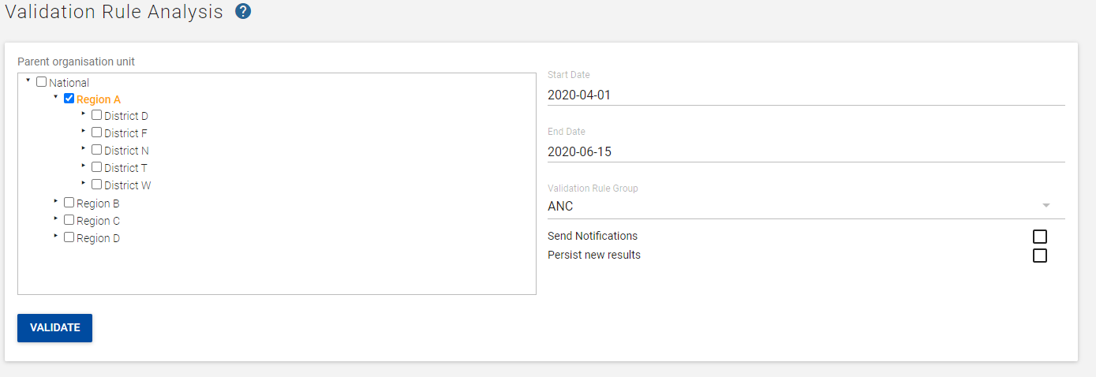
Running Validation Rule Analysis Finding out HOW to do this
Start Date: April 1
End Date: Today
Validation Rule Group: ANC
Organisation unit: Region A
Click Validate

Slide 31
Demo
https://academy.demos.dhis2.org/dqapp-config/

Slide 32
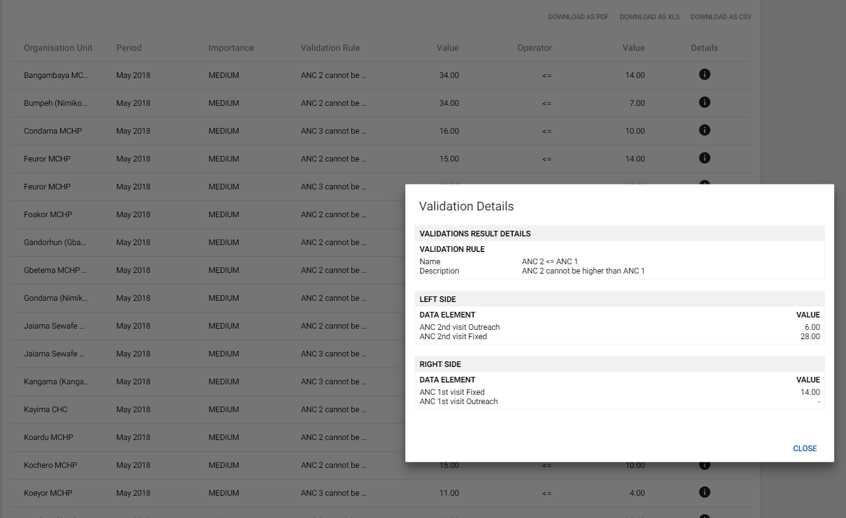
Running Validation Rule Analysis Seeing the results

Slide 33
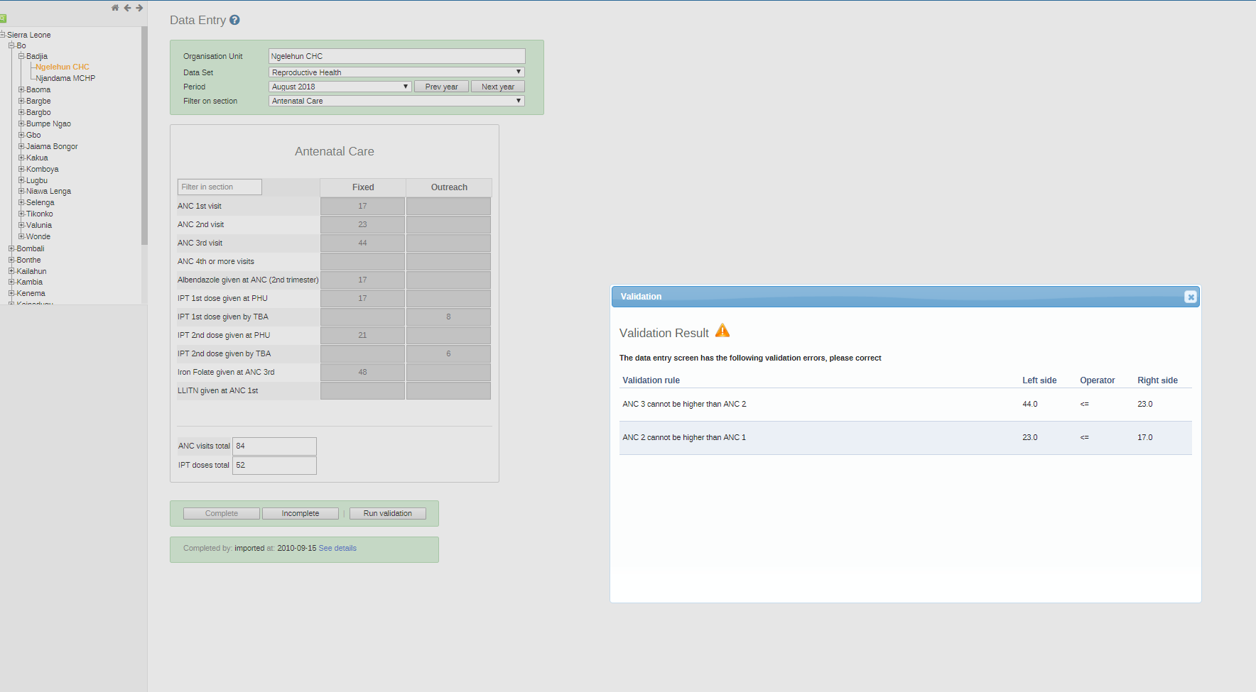
When to run validation rules:
Validation rules can run automatically or manually during data entry

Slide 34
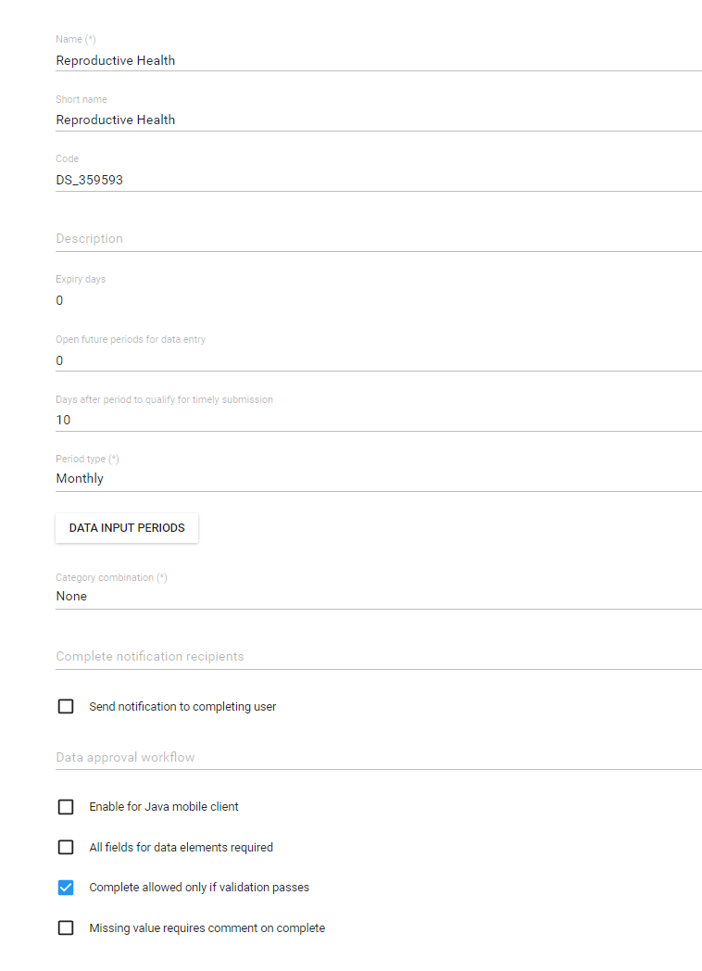
When to run validation rules:
Validation rules to prevent data completion
This can cause confusion, frustration, and hurt reporting completeness
When to do this:
Validation rules are well formed, tested, and verified
For well trained district or higher officers
Not for community health workers or poorly trained staff.

Slide 35
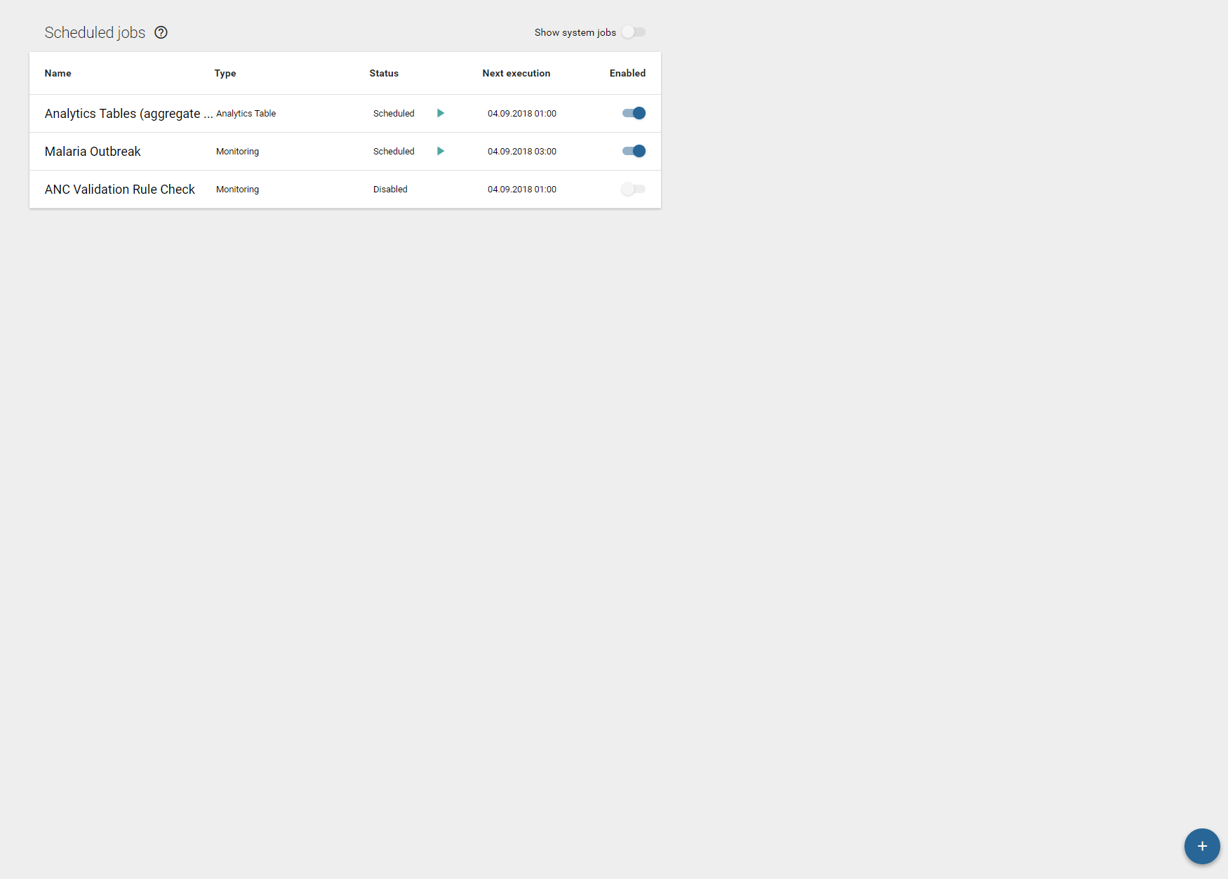
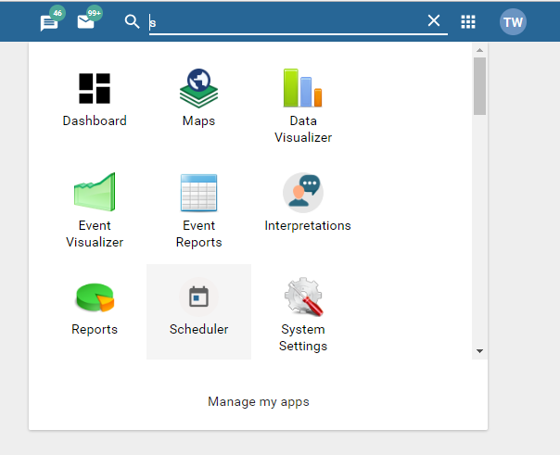
When to run validation rules: Automatically scheduled
Use scheduling app to make a new ‘monitoring job’

Slide 36
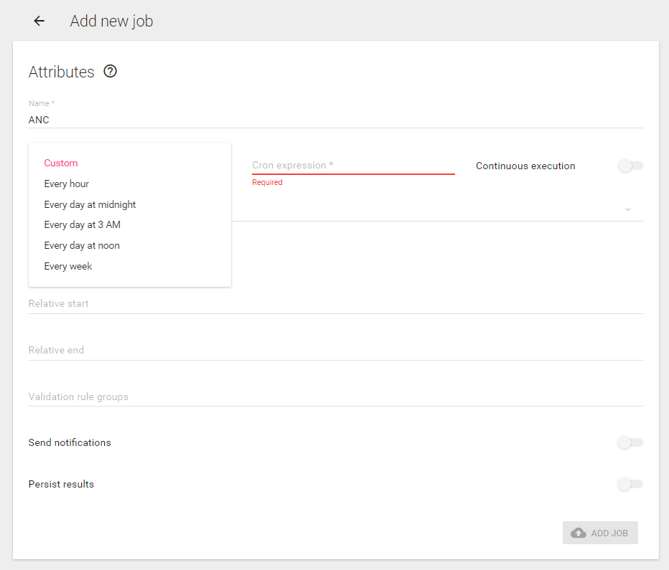
When to run validation rules: Automatically scheduled
Choose a premade frequency
OR
Write a custom cron expression
OR
Continuous expression – will constantly be running. Good if using for disease surviallance. Bad for many validation rules over long period

Slide 37
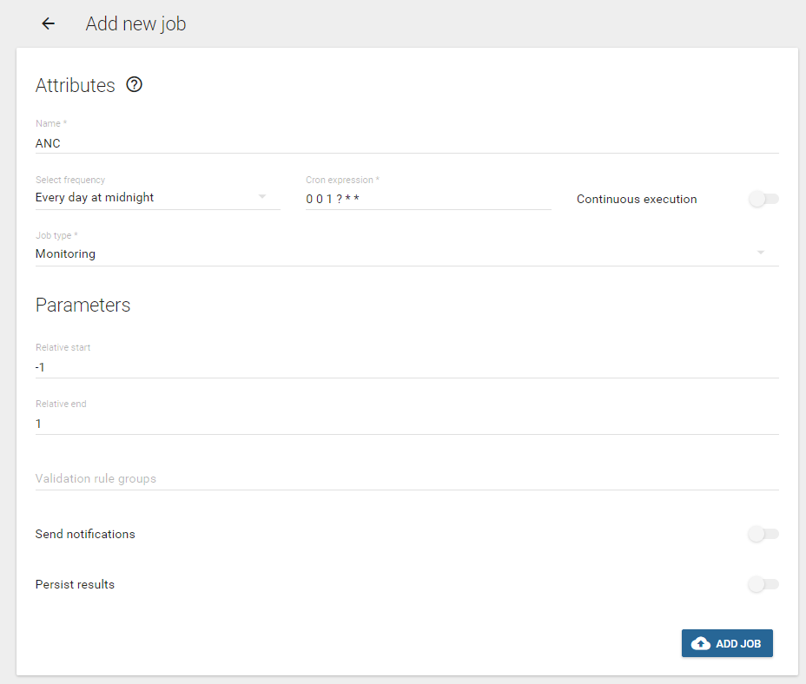
When to run validation rules: Automatically scheduled
The number of days in the past to run the validation rules for.
The number of days in the future to run the validation rules for.
-1 was yesterday and +1 is tomorrow; therefor, any data entered for any period that covers yesterday through tomorrow.
3 days
1 month, quarter, year, etc.

Slide 38
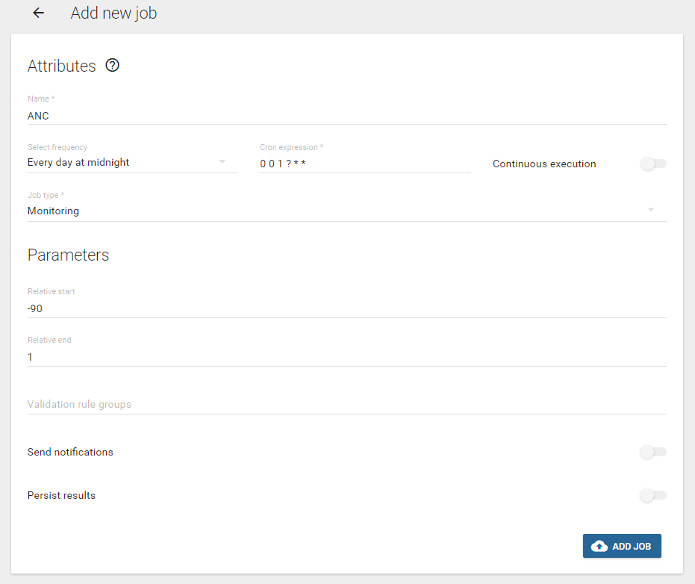
When to run validation rules: Automatically scheduled
-90 days is: March 24th
+1 day is: tomorrow
Between March 24th and tomorrow there is
91 days
4 months (including March.)
2 quarters
1 year

Slide 39
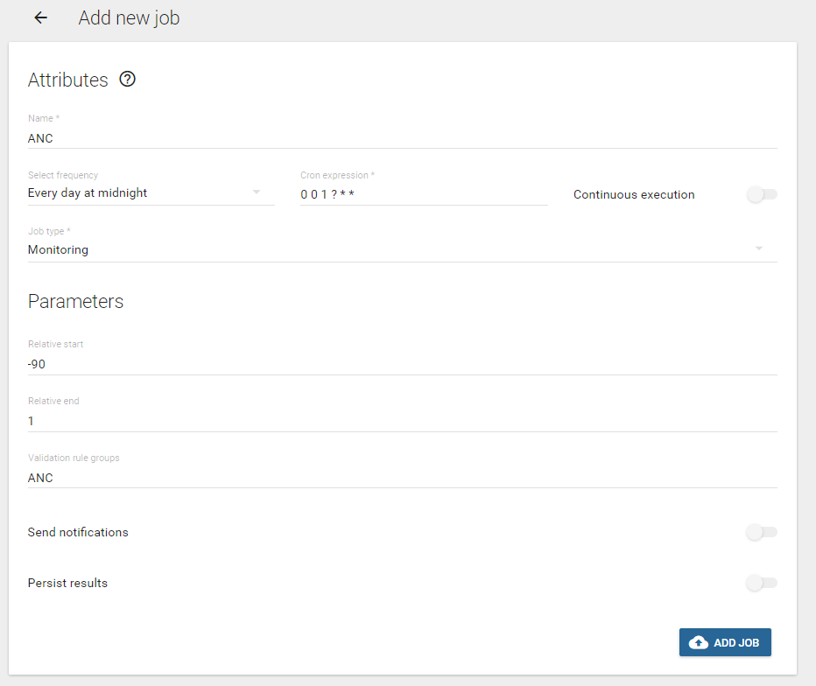
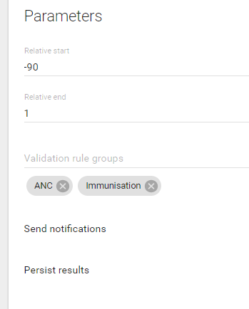
When to run validation rules: Automatically scheduled
Choose validation rule groups by typing and selecting
More than one can be selected

Slide 40
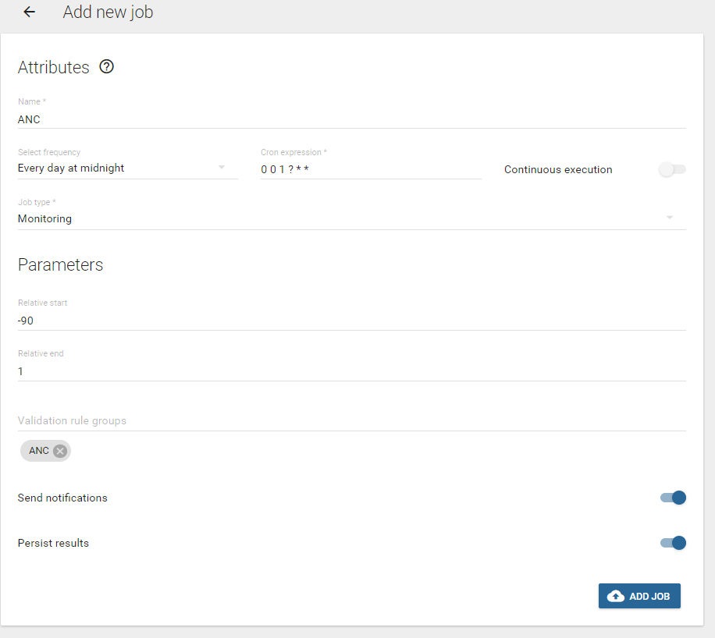
When to run validation rules: Automatically scheduled
Will automatically send notifications via email and sms if:
notifications are configured
email server is configured
sms gateway is configured
user is configured to recieve emails and sms

Slide 41
When to run validation rules: Automatically scheduled
Will ‘persist’ or save results, so that only new validation alerts are produced if they are detected.
No one wants to recieve the same validation rule alerts everyday.
Warning: could take up a lot of server space if you are persisting a lot of validation rules.

Slide 42
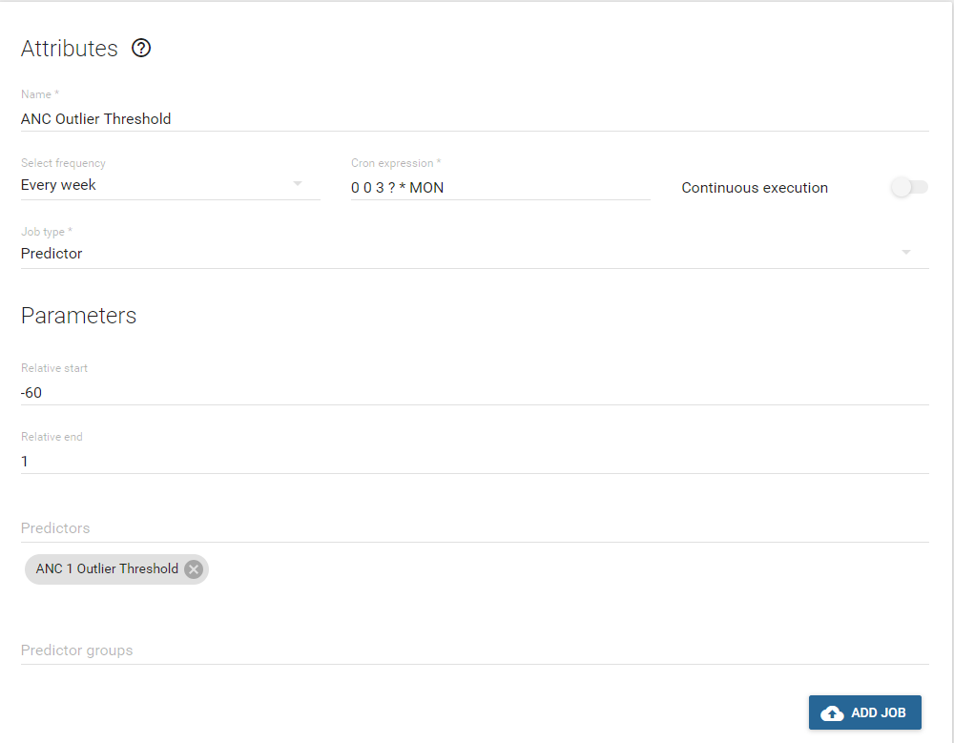
Scheduling predictor
Name
Select frequency: Every week
Job type: Predictor
Relative start: -60
Relative end: - 1

Slide 43
When to run validation rules: Automatically scheduled
A couple of best practices:
Schedule predictors to run before analytics tables
Schedule analytics tables before validation rules
Schedule just a few critical validations to run nighly or more frequently – disease surveillance and persist results
Schedule more, routine DQ checks to run weekly, monthly, or less frequently and make the relative period short: Start relative period = -20 and End relative period = 1
Scheduling Running
Predictors – 23:00 SUNDAY
Analytics tables – 24:00 SUNDAY
Validation Rules Alers – 03:00 Daily

Slide 44
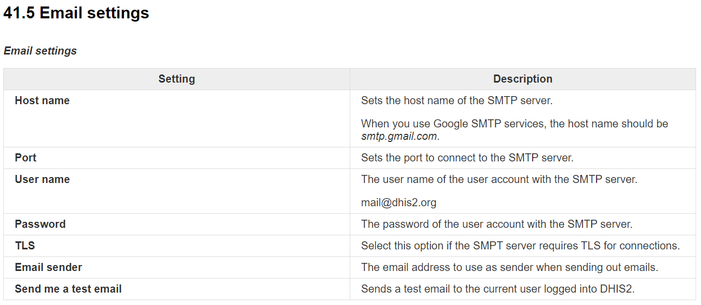
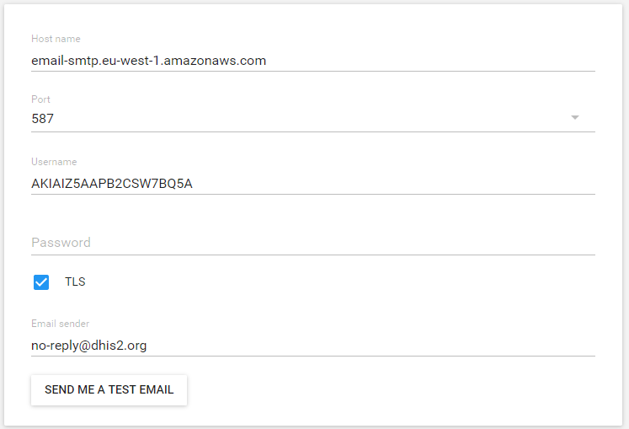
About Email – Get the information from your email host.

Slide 45
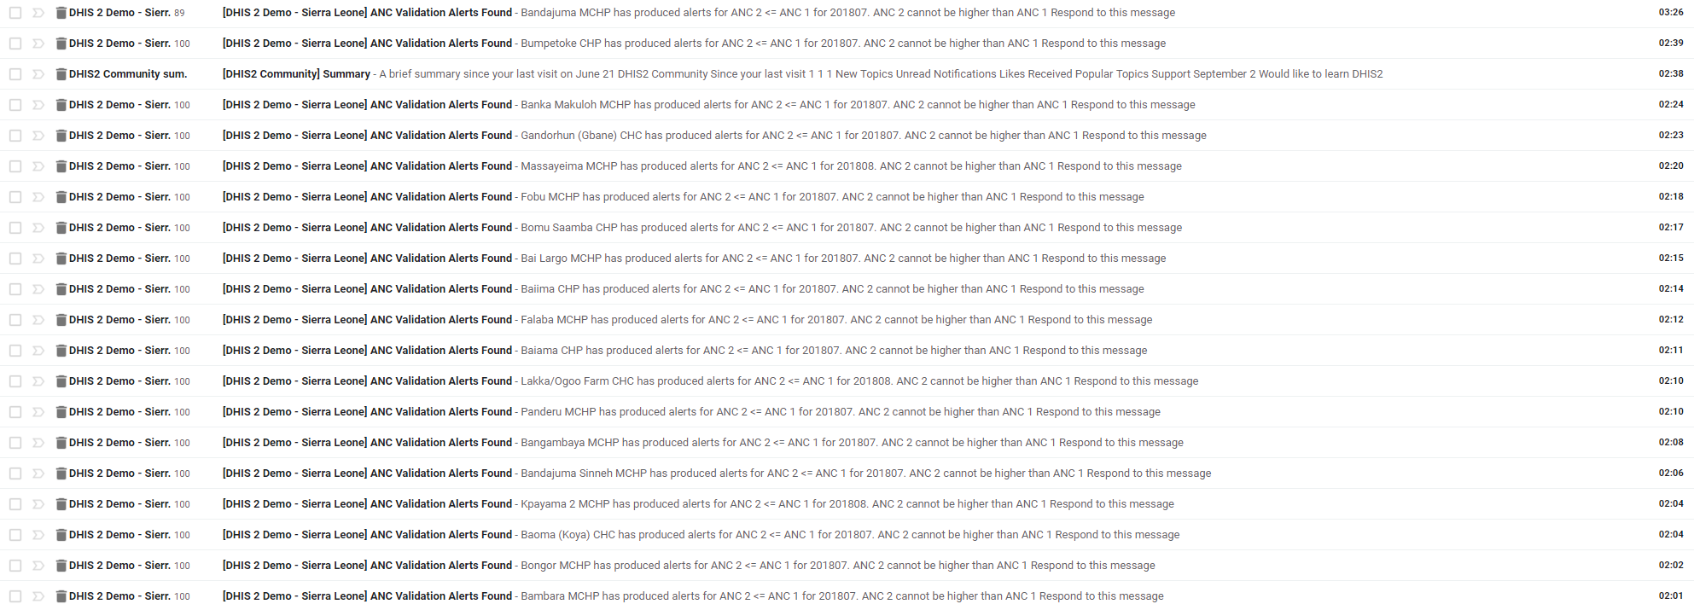
Automatic email alerts
Daily validation rule alert emails for ANC for whole country
2 validation rules makes:
19 emails
Approximatly 2000 alerts.
USEFUL??

Slide 46
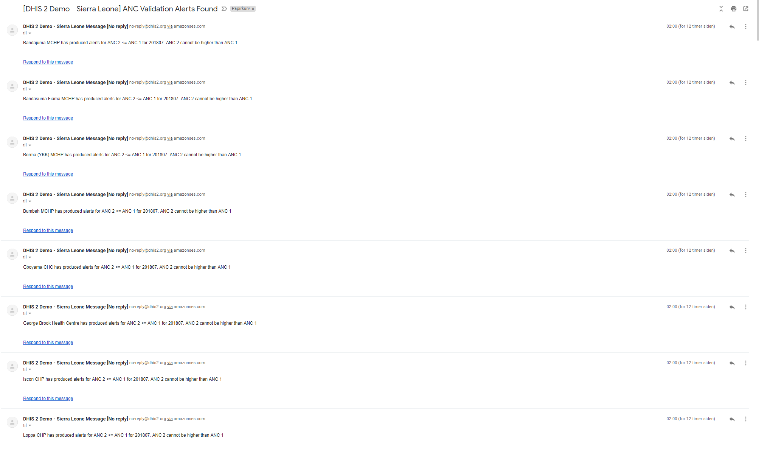
Automatic email alerts
Daily validation rule alert emails for ANC for whole country
2 validation rules makes:
19 emails
Approximatly 2000 alerts.
USEFUL?? NO

Slide 47
How and for whom can automatic validation email alerts be useful? Example from Rwanda outlier ditection to district officers on monthly basis →
From: "Rwanda HMIS Message [No reply]" <trainmutali@gmail.com> Date: June 6, 2019 at 10:00:00 PM PDT To: Undisclosed recipients: ; Subject: [Rwanda HMIS] Validation violations as of 2019-06-07T07:00:00 Violations: High 23, medium 0, low 0 A violation of the Penta 3 outlier data validation rule was detected at Batsinda HP for 201905 on 20 Please confirm that the value is correct of Penta 3 A violation of the Penta 3 outlier data validation rule was detected at Bumbogo (ex-Gikomero I) CS f Please confirm that the value is correct of Penta 3 A violation of the Penta 3 outlier data validation rule was detected at Cyuga HP for 201905 on 2019- Please confirm that the value is correct of Penta 3 A violation of the Penta 3 outlier data validation rule was detected at Cyumba CS for 201905 on 2019 Please confirm that the value is correct of Penta 3 A violation of the Penta 3 outlier data validation rule was detected at Gatsata CS for 201905 on 201 Please confirm that the value is correct of Penta 3 A violation of the Penta 3 outlier data validation rule was detected at Gikore CS for 201905 on 2019 Please confirm that the value is correct of Penta 3 A violation of the Penta 3 outlier data validation rule was detected at Gitarama CS for 201905 on 20 Please confirm that the value is correct of Penta 3 A violation of the Penta 3 outlier data validation rule was detected at Gitwe CS for 201905 on 2019- Please confirm that the value is correct of Penta 3 A violation of the Penta 3 outlier data validation rule was detected at Harmony Clin for 201905 on 2 Please confirm that the value is correct of Penta 3 A violation of the Penta 3 outlier data validation rule was detected at Jenda (nyabihu) HP for 20190 Please confirm that the value is correct of Penta 3 A violation of the Penta 3 outlier data validation rule was detected at Kirambi CS for 201905 on 201 Please confirm that the value is correct of Penta 3 A violation of the Penta 3 outlier data validation rule was detected at Kirarambogo CS for 201905 on Please confirm that the value is correct of Penta 3 A violation of the Penta 3 outlier data validation rule was detected at Ntoma CS for 201905 on 2019- Please confirm that the value is correct of Penta 3 A violation of the Penta 3 outlier data validation rule was detected at Nyarugunga CS for 201905 on Please confirm that the value is correct of Penta 3 A violation of the Penta 3 outlier data validation rule was detected at Rubengera CS for 201905 on 2 Please confirm that the value is correct of Penta 3 A violation of the Penta 3 outlier data validation rule was detected at Ruheru CS for 201905 on 2019 Please confirm that the value is correct of Penta 3 A violation of the Penta 3 outlier data validation rule was detected at Rusizi CS for 201905 on 2019 Please confirm that the value is correct of Penta 3 A violation of the Penta 3 outlier data validation rule was detected at Rutare (gicumbi) CS for 2019 Please confirm that the value is correct of Penta 3 A violation of the Penta 3 outlier data validation rule was detected at Rutonde CS for 201905 on 201 Please confirm that the value is correct of Penta 3 A violation of the Penta 3 outlier data validation rule was detected at Rwimitereri CS for 201905 on Please confirm that the value is correct of Penta 3 A violation of the Penta 3 outlier data validation rule was detected at Sovu (Ngororero) CS for 2019 Please confirm that the value is correct of Penta 3 A violation of the Penta 3 outlier data validation rule was detected at St Pierre DISP for 201905 on Please confirm that the value is correct of Penta 3 A violation of the Penta 3 outlier data validation rule was detected at Tare CS for 201905 on 2019-0 Please confirm that the value is correct of Penta 3

Slide 48
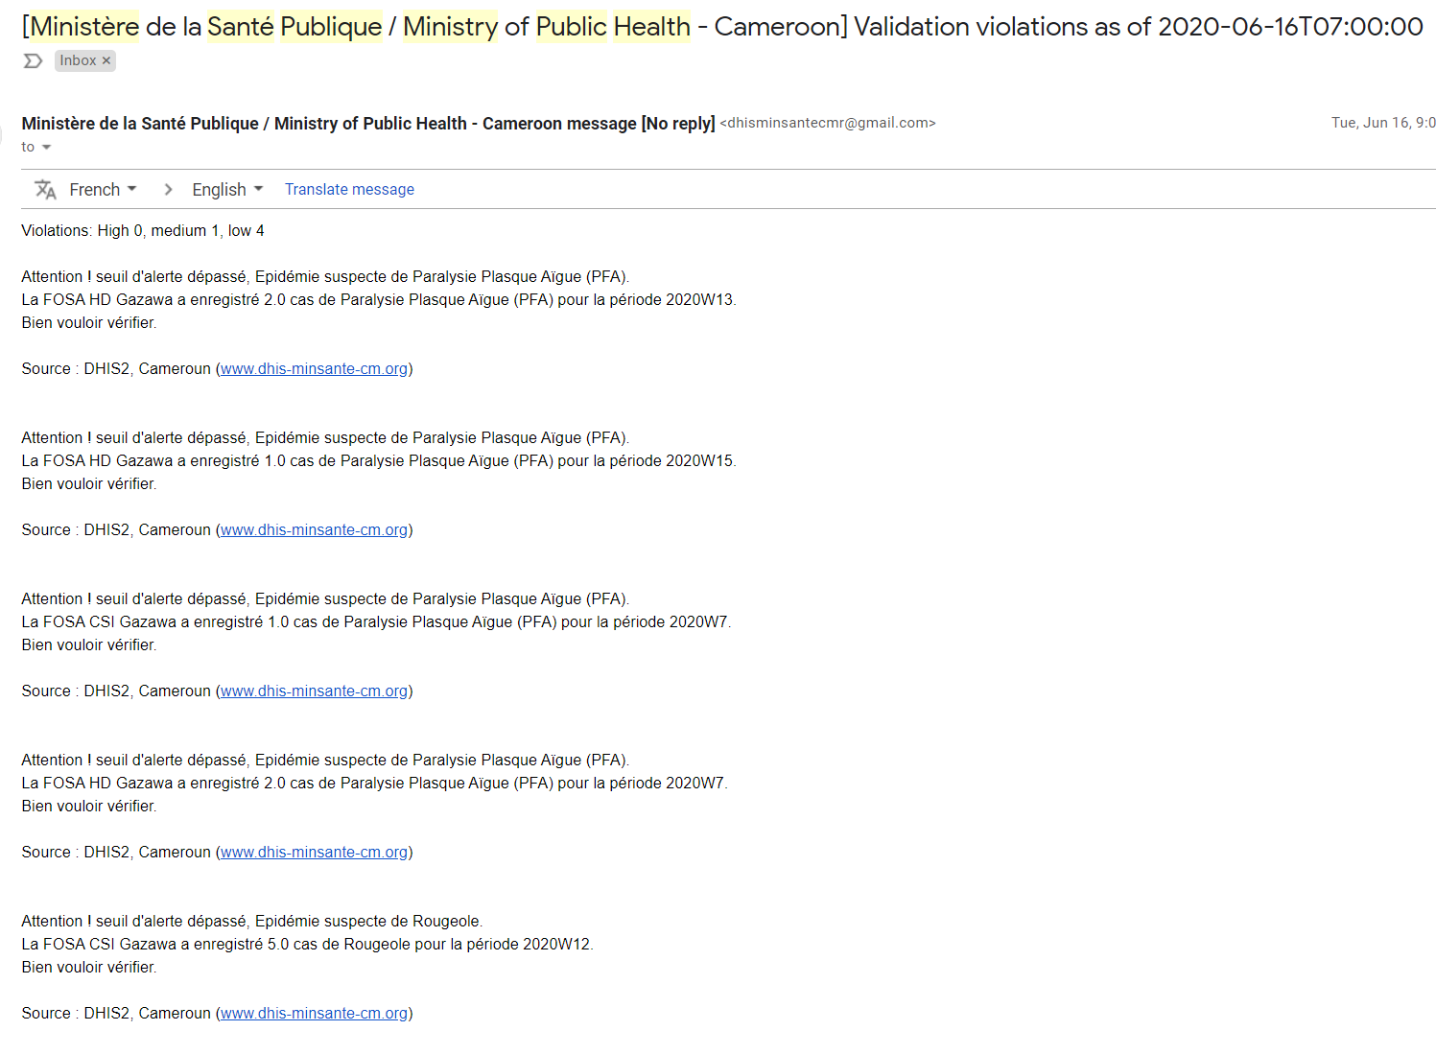
How and for whom can automatic validation email alerts be useful? Example from Cameroon on disease surviallance on a dialy basis to national IDSR team →

Slide 49
Data Quality SoPs
Defines what actions to take by everyone.
What is the process for each person
What automated messages does each person recieve
User groups for messages
Org unit contact details are updated

